Slide 1
Azure Data Factory SETUP

Slide 2
Why ADF
ADF is managed cloud service that’s build for complex hybrid Extract-transform-load (ETL) and Extract load transform (ELT) and data integration project
Data movement: ADF allows for seamless data transfer between various data stores
Data transformation: the service provide the ability to provide clean, shape and transform data through it’s built in transformation or custom code
Big data processing: ADF enables efficient processing of the big data.

Slide 3
Benefits of ADF
Scalability: service can handle large loads and can be scaled up or down
Integration: ADF integrates with other azure services
Cost-effectiveness: Organization can reduce the cost with expensive on premises infrastructure.
Security: Azure active directory authentication, network security and encryption at rest
Flexibility: With support for wise range of data formats, protocols and technologies.

Slide 4
Project requirement
Create lake gen2 storage account
Create a data factory
Azure SQL DB
Azure data studio download
Setting the Azure data studio
Create a sql server VM (keep on hold)

Slide 5
Azure SQL DB setting
Database name : adf-demo-sql-db
Server login: coach
Password : train@12
Make the public endpoint enable from networking
Allow azure services and resources to access this server as yes
Once the resource is created then change the firewall settings. Goto overview -> set server firewall
From networking add firewall rules->add client IP address
To allow access to add a firewall rule:
Name :ALLIP startIP: 0.0.0.0 endIP:255.255.255.255

Slide 6
Create the table
create table employee
( Name varchar(max),
Gender varchar(max),
Dept varchar(max),
)
select * from employee;
insert into dbo.employee(Name, Gender, Dept) VALUES ('Tanmoy', 'M', 'IT');
insert into dbo.employee(Name, Gender, Dept) VALUES ('Roop', 'M', 'HR');
insert into dbo.employee(Name, Gender, Dept) VALUES ('Malathy', 'F', 'IT');
insert into dbo.employee(Name, Gender, Dept) VALUES ('Kranthi', 'M', 'HR');
insert into dbo.employee(Name, Gender, Dept) VALUES ('Bhuvi', 'F', 'Payrole');

Slide 7
Building blocks of ADF
Pipelines
activities
datasets
Linked devices
Triggers
Interconnecting above componenet

Slide 8
Pipeline
Logical grouping of activities in a sequential manner
Example:
Ingest the data from data lake storage to Azure Blob Storage and then store the ingestion details inside a SQL DB

Slide 9
Few examples
Create a pipeline provide the name
Select the activity copy data -> store procedure

Slide 10
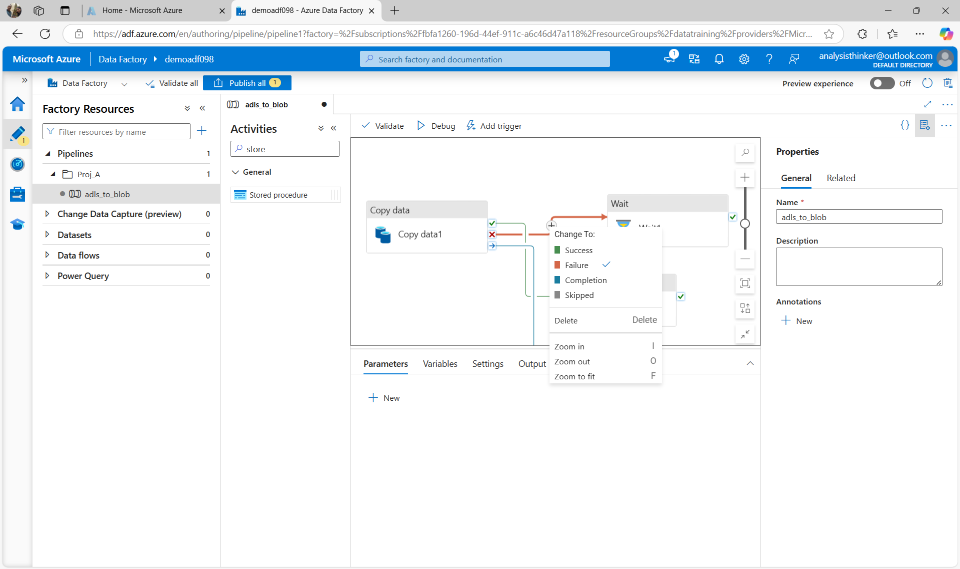
Activities

Slide 11
Activities
Success : move to next activity only when there is first process successfully completed
Failure: move to next activity only when previous activity failed
Completion: Completion of the first activity
Skipped:

Slide 12
Linked Services
Connection string to connect the data factory with external resources
Example connecting lakegen2 to datafactory
Navigate to manage - > connections -> linked services-> new
New pan with different connection will appear
Select lakegen2 having following fields
Connect -> AutoResolveIntegrationRuntime
Key -> accountkey
Pass the proper storage name
Test the connection and create

